Slide 1
ASYNC & AWAIT
Asynchronous Programming with:
Andrew Jackson Senior Engineer andrew.jackson@aderant.com
http://andrewjackson.name/blog

Slide 2
Asynchronous Programming?
Higher demands on UI
Customers expect better experiences
Devices / touch experiences
Connected devices – greater latency
Building asynchronous applications can be complex and tedious
Need better language abstractions
Futures based programming – Tasks in .NET

Slide 3
Synchronous vs Asynchronous
Synchronous – Wait for result before returning IData data = DownloadFile(…); ProcessData(data);
Asynchronous – Return now, call back with result Task<IData> future = DownloadFileAsync(…); future.ContinueWith(data => ProcessData(data));
BLOCKED!
DownloadFile
ProcessData
DownloadFileAsync
ProcessData

Slide 4
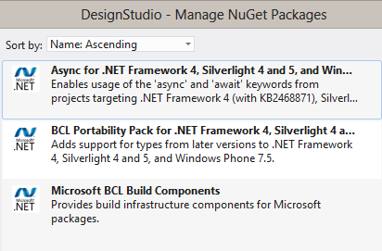
New Language Features
“async” and “await” keywords
Reduces complexity by removing call-backs
Further abstraction on .NET Tasks (TPL)
Requirements:
Visual Studio 2012
.NET 4.5 (or .NET 4.0 with additional “Microsoft.Bcl.Async” NuGet package)

Slide 5
DEMO
Ok, I’ll stop talking and just show you some stuff… you can always google for more information…

